Slide 1
YouTube comments on Oscar-nominated movie trailers
Data Mining and Business Intelligence
Pooja Shah

Slide 2
Table of Contents
Introduction
Exploration of Data
Key trends and insights
Business Recommendation
Appendix

Slide 3





Introduction
Database pertains to Youtube comments on Oscar nominated movie trailers for 4 select few movies:
32070 rows x 8 columns
Comments on movie trailers with date timestamp
Movies selected are as below:
Dunkirk - History/War
The Shape of Water - Romance/Fantasy
Phantom Thread - Romance/Drama
Get Out - Psychological Thriller/Horror

Slide 4
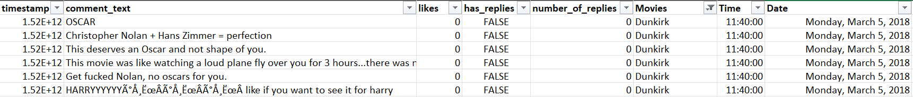
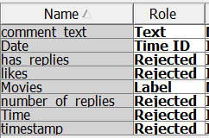
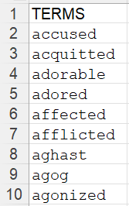
Data pre-processing:
In the process of cleaning the dataset:
Combine all 4 selected movies in one dataset
And keep all 4 selected movies separated
Change timestamp to Time and Date
Added one more column to name the movies
SAS Enterprise Miner Workstation process:
Importing the file:
All 4 selected movies in one dataset
Separated 4 selected movie name in 4 dataset
In Text Parsing, we added the table: type of emotions in Filter tab for separated movie dataset

Slide 5
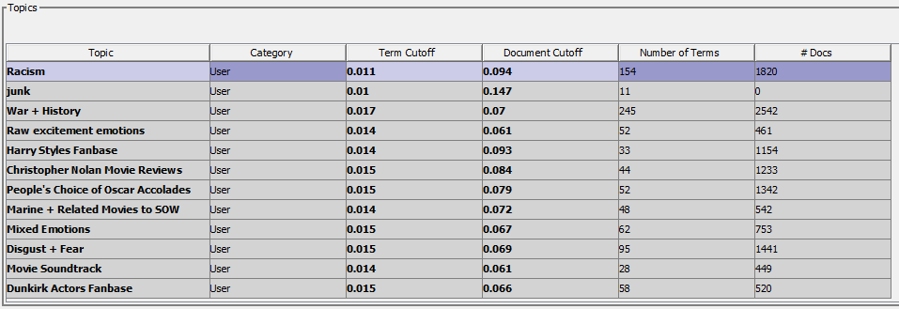
Exploration of Data : 4 Movies together
For all 4 movies together, mixed set of reactions
Racism is a widely talked about topic
Nolan movies carry a huge fan base

Slide 6
Diving deeper into data

Slide 7
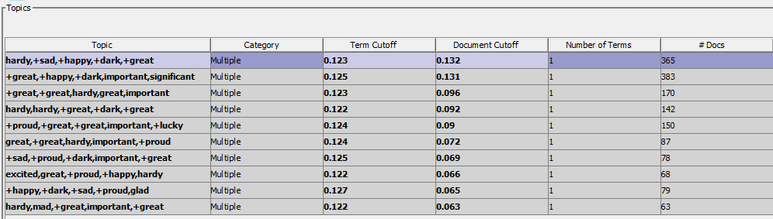
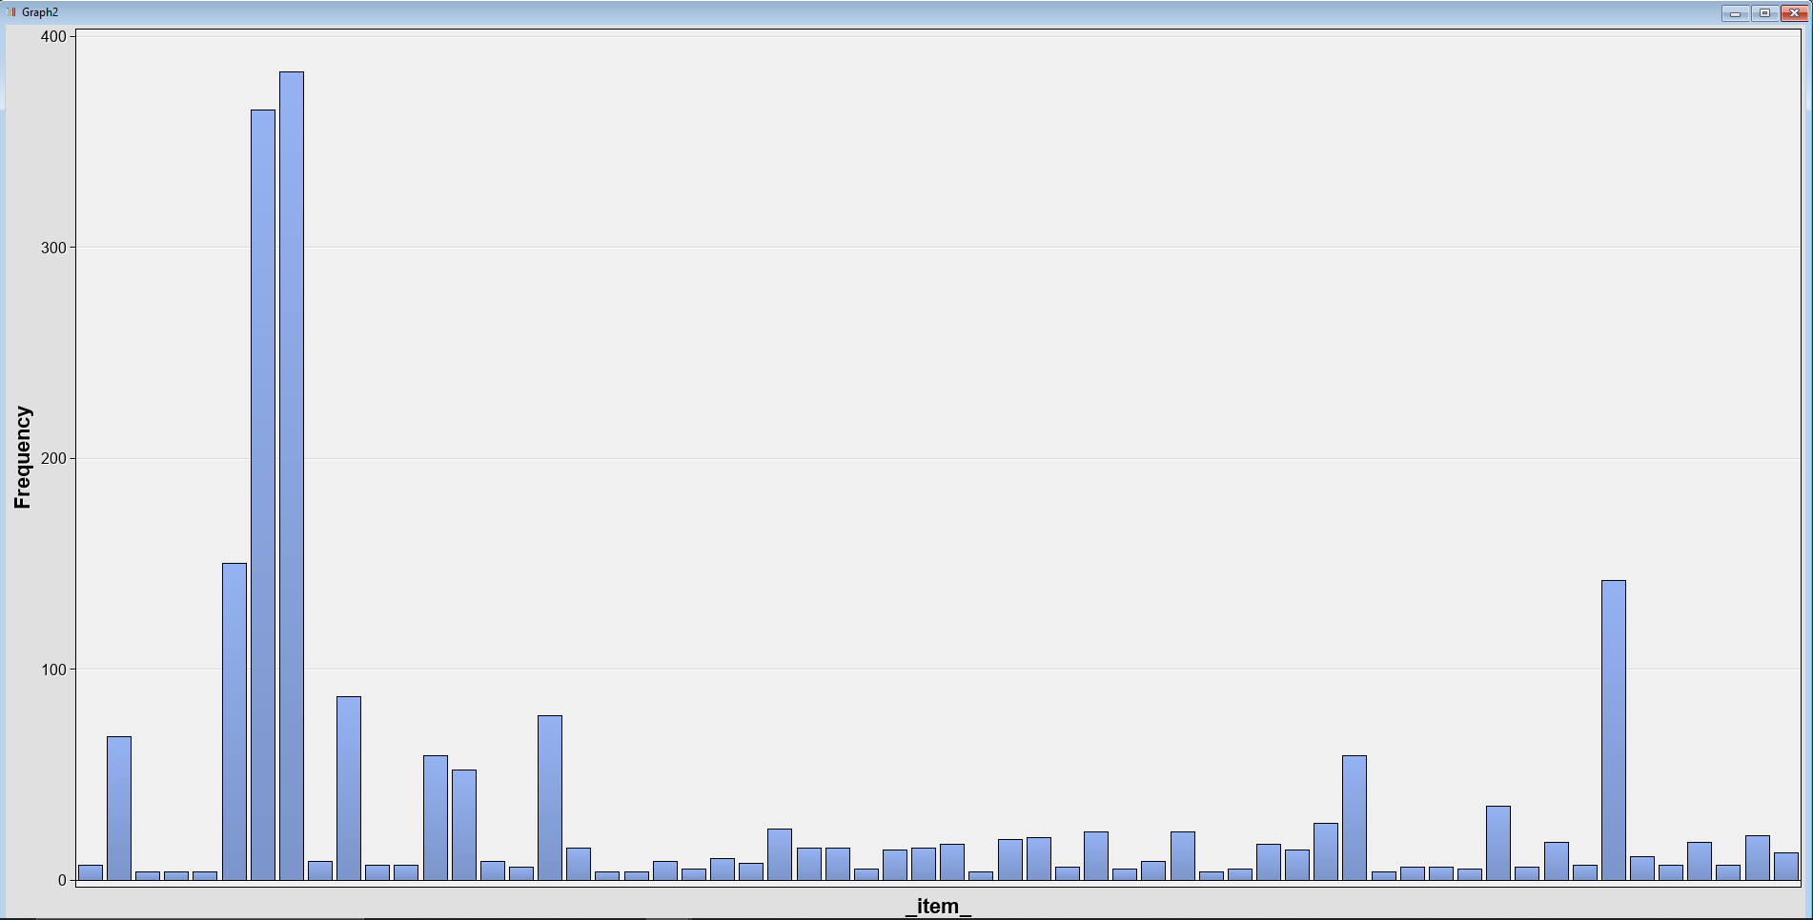
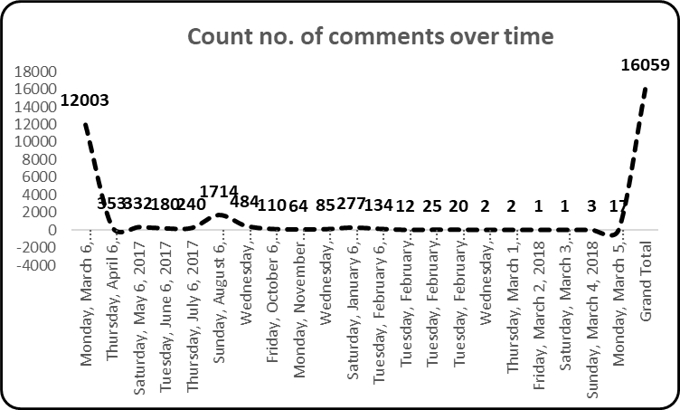
Exploration of Data - Dunkirk
Key topics
great, hardy, proud, fantastic, sad, important, glad

Slide 8
Sentiment Analysis - Dunkirk
Dedicated
Happy
Lost
Upset

Slide 9

Exploration of Data - Dunkirk

Slide 10
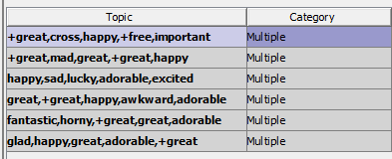
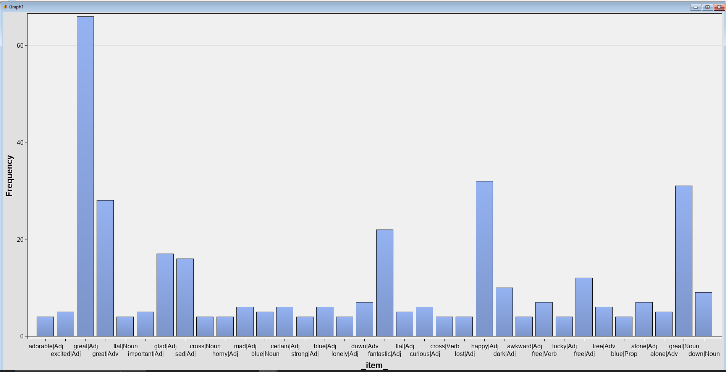
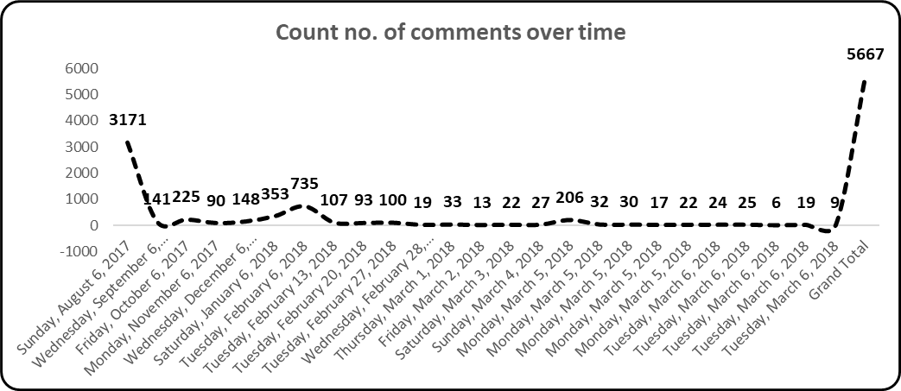
Exploration of Data - The Shape of Water
Key topics
great, sad, happy, free, dark

Slide 11
Sentiment Analysis - The Shape of Water
Great
Fantastic
Happy

Slide 12
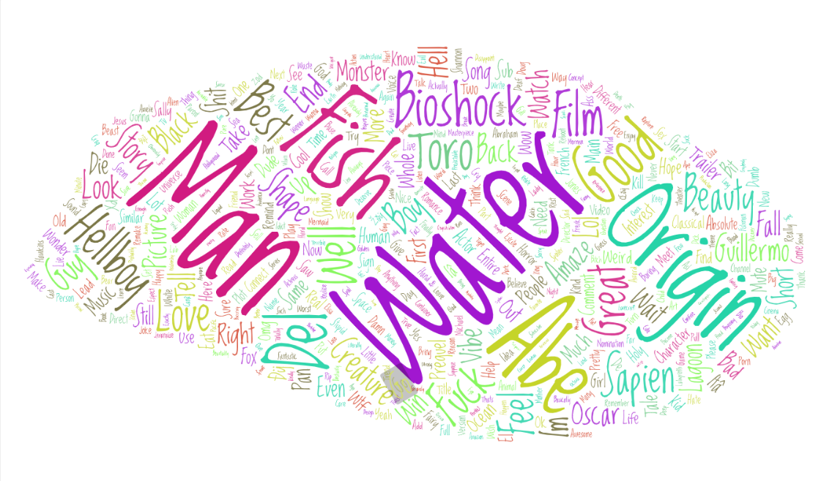
Exploration of Data - The Shape of Water

Slide 13
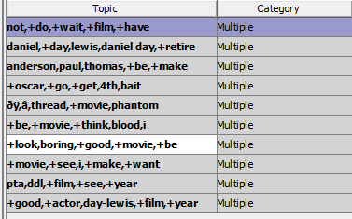
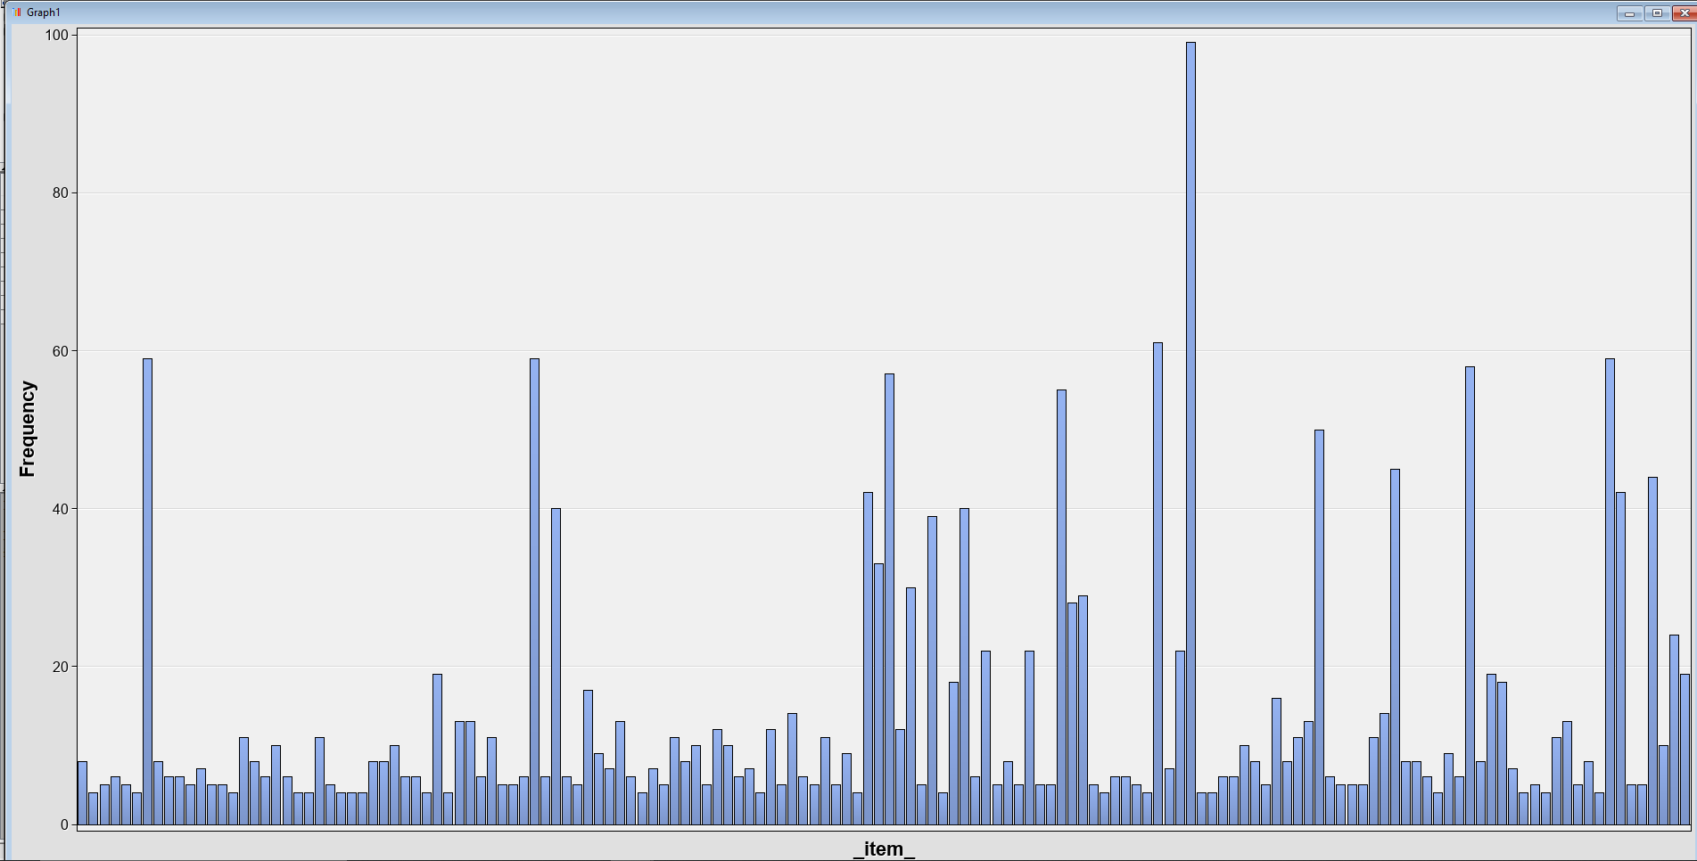
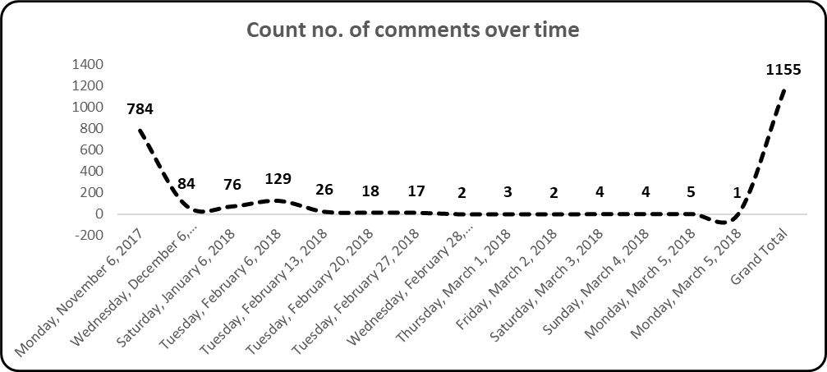
Exploration of Data - Phantom Thread
Key topics
great, good, boring, best, beautiful

Slide 14
Sentiment Analysis - Phantom Thread
Glad
More
Bad
Notes:
.

Slide 15
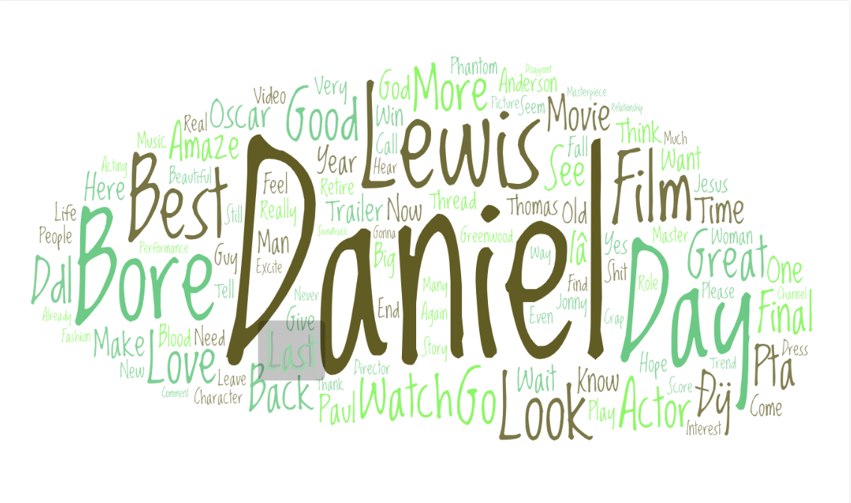
Exploration of Data - Phantom Thread

Slide 16
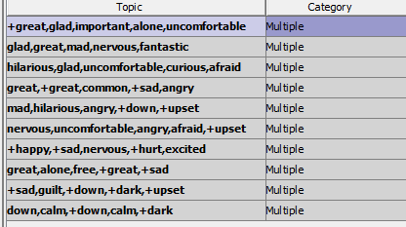
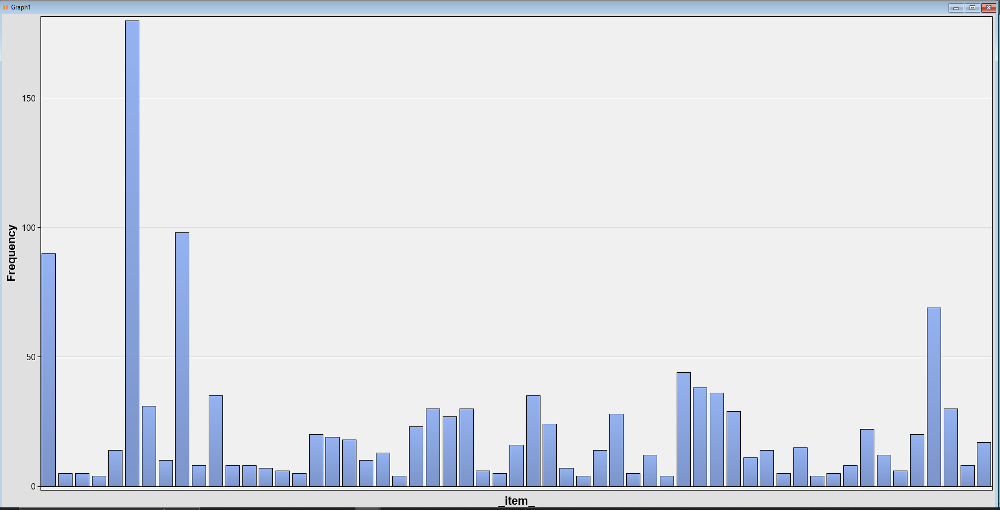
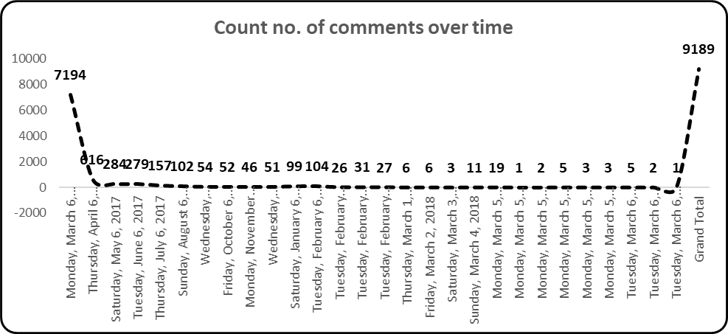
Exploration of Data - Get Out
Key topics
great, hilarious, glad, sad, mad

Slide 17
Sentiment Analysis – Get Out
Loving
Uncomfortable
Dark

Slide 18
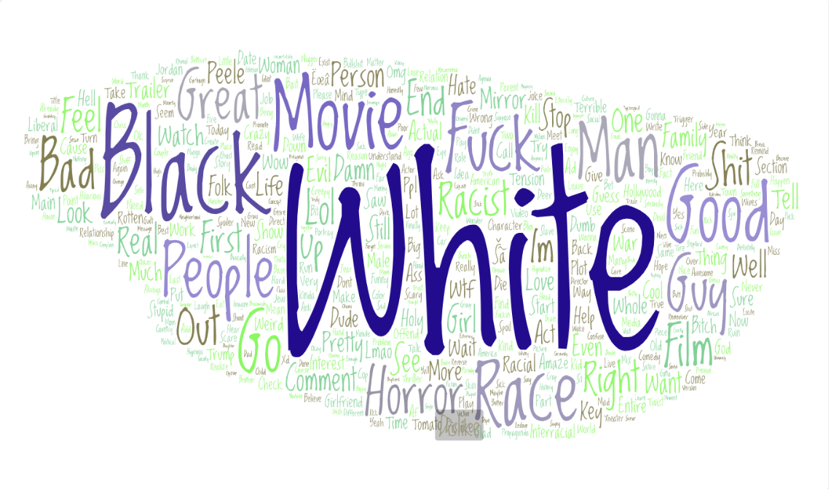
Exploration of Data - Get Out

Slide 19

Key trends and insights

Slide 20



Key trends and insights
People gravitate towards war and action movies
People tend to reflect negatively on topics which are sensitive and attracts a lot of flak amongst viewers if not portrayed well
Actors and Actresses can overpower the fame a movie can get and influence viewership driven by crazy fan-base to a very large extend

Slide 21

Business Recommendations
War and history are the topics of interest to the reviewers. Youtube and other media platforms can look at creating content along those lines.
A huge chunk of revenue generation depends on the actor / actress casted. Highly acclaimed actors earn higher viewership and hence increase revenue generation.
The degree of viewership tends to increase as there are events like nomination announcements, trailer launches, etc. Doing events around those time frames can help drive revenue generation due to higher CTR and viewerships.

